Slide 1
Virtualization and VMs

Slide 2
What is Virtualization?
Virtualization is technology that allows you to create multiple simulated environments or dedicated resources from a single, physical hardware system
Software called a hypervisor connects directly to that hardware and allows you to split 1 system into separate, distinct, and secure environments known as virtual machines (VMs)
Taken from https://www.redhat.com/en/topics/virtualization

Slide 3
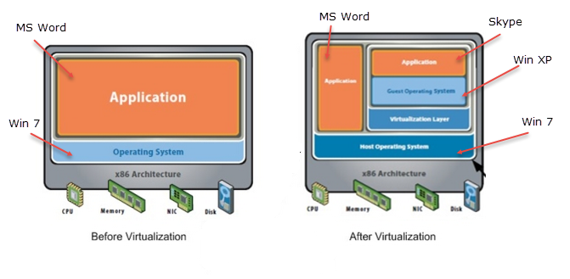
So what is a virtual machine or VM?
An isolated software container with an operating system and application inside.
VMs are independent of one another and are somewhat similar to a “sandbox”

Slide 4
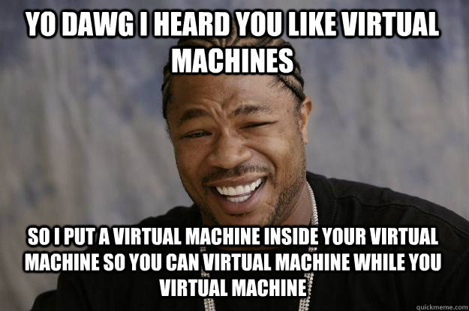
Why use virtualization?
The cost of hardware has gone down while the performance has increased
Allows for better utilization of resources
Much, MUCH cheaper than buying 20 different machines for 20 different purposes

Slide 5

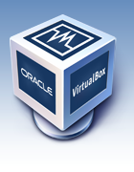
Virtualization Softwares
2 main ones: VirtualBox and VMware
For our sake, we will be using VirtualBox. If you have VMware, that is fine but we recommend Virtualbox.

Slide 6
Questions?

Slide 7
Downloads
VirtualBox - https://www.virtualbox.org/wiki/Downloads
Please download the platform package for your respective operating system as well as the extension pack
Kali Linux - https://www.offensive-security.com/kali-linux-vmware-virtualbox-image-download/
Ubuntu - https://www.ubuntu.com/download/desktop
Download Ubuntu 16.04.3 LTS

Slide 8
Lab - VM Setup
Explore VirtualBox
Setup your Kali Linux VM by importing the .ova file you downloaded
Open VirtualBox and import the Kali .ova file
Setup second network adapter to be host-only
Setup your Ubuntu VM
16 gb of disk storage
Dynamically allocated storage
Atleast 1024 mb of RAM (2048 mb recommended if possible based upon your laptop hardware)

Slide 9
Lab part 2 - Exploration
Explore Kali Linux
Expose yourself to the various Penetration Testing tools that people use today
Perform an update
Explore Ubuntu
Familiarize yourself with the linux environment
Perform an update
Customize a little bit
Learn what a ‘snapshot’ is and take one of each of your VMs
Make the two virtual machines talk to each other

